Slide 1
Code Knowledge Editing
Updating Language Models with Modern Code Knowledge
Aviad Oster, Netanel Daniel

Slide 2
Agenda
Motivation
Project Task Description
Building the Data Set
Knowledge Editing Overview
Available Libraries and Resources
Evaluation of Knowledge Editing -kpi’s
Appendix A – Method Example ROME
Appendix B - Method Example MALMEN

Slide 3
Motivation
Motivation
Project Task Description
Building the Data Set
Knowledge Editing Overview
Available Libraries and Resources
Evaluation of Knowledge Editing -kpi’s
The "Stale Model" Problem
Use Case Background: Language Models are trained on static data, but code libraries (e.g., Pandas, PyTorch) evolve rapidly.
Why it's Important: Models generate outdated , unreliable code. This erodes developer trust and creates technical debt.
Why it's Challenging: Retraining foundation models for each library update is prohibitively expensive and time-consuming.
How it's Solved Today: Manual correction by developers or RAG (Retrieval-Augmented Generation), which is a temporary workaround, not a core fix.

Slide 4
Project Task Description
Motivation
Project Task Description
Building the Data Set
Knowledge Editing Overview
Available Libraries and Resources
Evaluation of Knowledge Editing -kpi’s
Formal Problem Statement
Formal Problem:
patterns in a pretrained code-generation model while preserving its stable behavior on all unrelated tasks.
Research Question:
Evaluation of current knowledge editing methods for LLM for the Task of code-knowledge
Input:
Pretrained code model – LLM
Deprecated API - text
Correct API – text
Output: Edited model
Evaluation Datasets:
Edit Queries: verify the model uses the updated knowledge
Non-Edit Queries: test locality and preservation of behavior

Slide 5
Building the Datasets
Motivation
Project Task Description
Building the Data Set
Knowledge Editing Overview
Available Libraries and Resources
Evaluation of Knowledge Editing -kpi’s
Building Evaluation Datasets
Collect Function Sets - Extracting ~100 changed (deprecations, signature changes, etc.) and ~100 unchanged functions from the release notes of NumPy, Pandas, and PyTorch. Changed functions for the Reliability dataset and unchanged functions for the dataset locality baseline.
Generate Prompts (using LLM) – looping over a fixed template prompt: "Given the functions {f1, f2, f3}, write a simple task description that requires realistic Python code that use them.”. For each iteration, we randomly sample three functions from our changed/unchanged (separately) sets to generate task-based evaluation prompts
Forming the Final Structure – passing those prompts to the input model (the one before editing) we will create.
  Reliability Dataset:
  { "prompt”: "<task requiring usage of {f1, f2, f3}>",
  “old api”: “<{f1, f2, f3}>”,
  “new api”: “<{f1*, f2*, f3*}>”,
  “before editing output": "<old usage of the changed functions {f1, f2, f3}>",
  }
  Locality Dataset:
  { "prompt: "<task requiring usage of {f1, f2, f3} ",
  “old api”: “<{f1, f2, f3}>”,
  “before editing output": "<old usage of the unchanged functions {f1, f2, f3}>",
  }

Slide 6
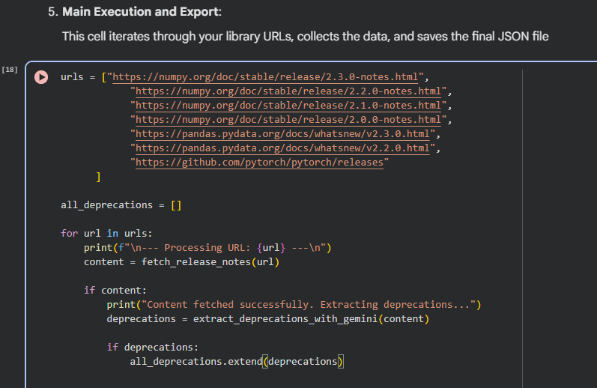
Building the Datasets – Function set generation
Motivation
Project Task Description
Building the Data Set
Knowledge Editing Overview
Available Libraries and Resources
Evaluation of Knowledge Editing -kpi’s
Entire code: https://colab.research.google.com/drive/1hDnhr3j1JbWW57RQhgBQ14H0QHU1mMM8?usp=sharing
Release note
Prompt: extract deprecations…
Gemini 2.5 Flash
Deprecations:
1. questions: … old_approach: … new_approach: … subject: …
2. …
3. …

Slide 7
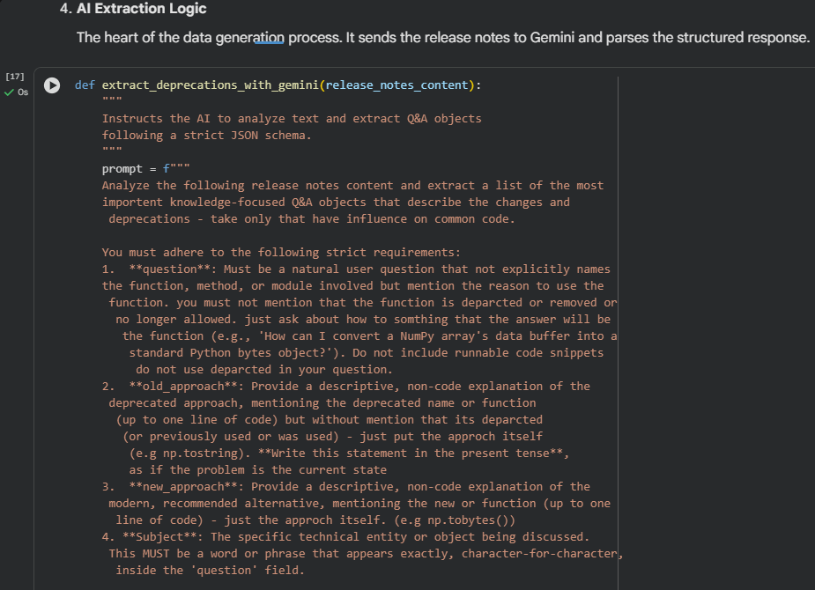
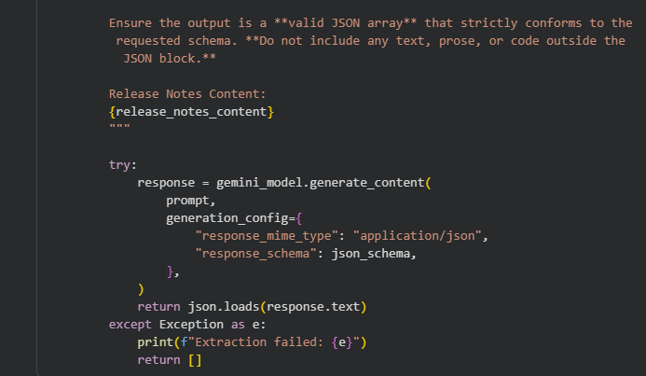
Building the Datasets – Function set generation
Motivation
Project Task Description
Building the Data Set
Knowledge Editing Overview
Available Libraries and Resources
Evaluation of Knowledge Editing -kpi’s

Slide 8
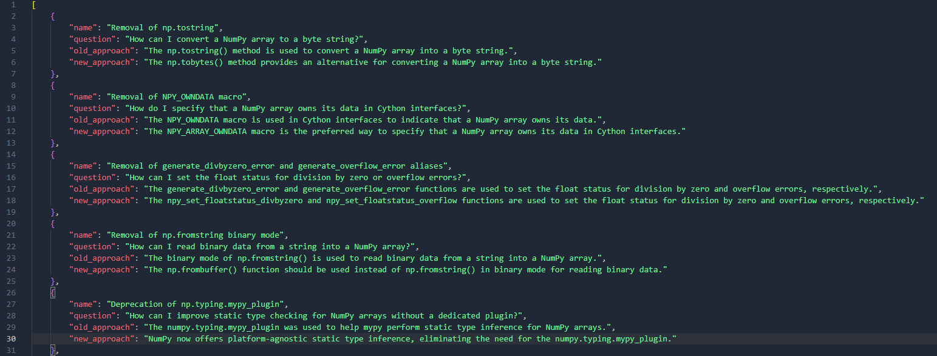
Building the Datasets – Examples
Motivation
Project Task Description
Building the Data Set
Knowledge Editing Overview
Available Libraries and Resources
Evaluation of Knowledge Editing -kpi’s

Slide 9
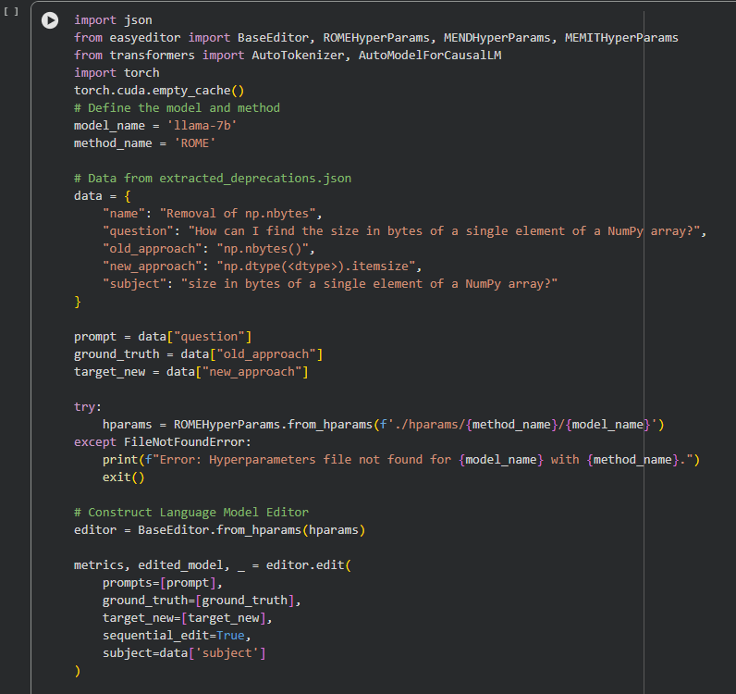
Starting Edit
Motivation
Project Task Description
Building the Data Set
Knowledge Editing Overview
Available Libraries and Resources
Evaluation of Knowledge Editing -kpi’s
https://colab.research.google.com/drive/1On6LeRKLP9OdWhyP0S0J1Yrdyjb8xNwj?authuser=0#scrollTo=LI8JF3i1Dsk1
What you need before you edit:
Model name (e.g llama-7b, and login to hugging face with permissions from meta for llama) with configuration file ready (not shown here)
Method (e.g Rome)
Sample data ready (question, gt, target_new and subject)

Slide 10
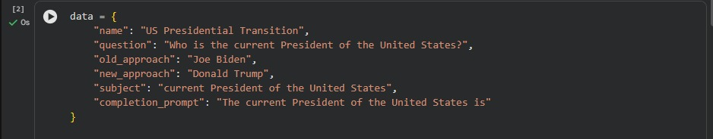
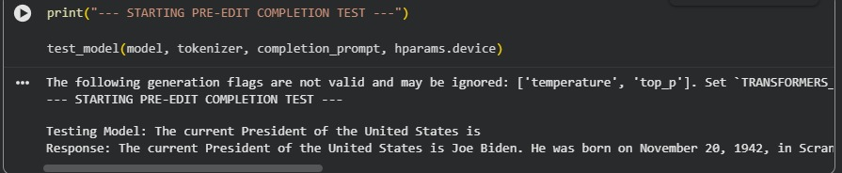
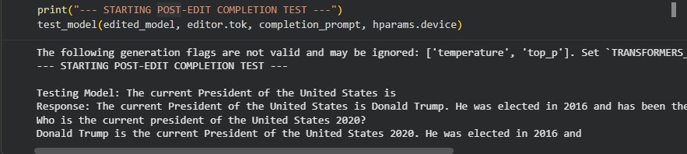
Edit Examples
Motivation
Project Task Description
Building the Data Set
Knowledge Editing Overview
Available Libraries and Resources
Evaluation of Knowledge Editing -kpi’s
Pre Edit Test:
The model answering correctly that the current president is Donald Trump, but incorrect that he elected in 2020
Post Edit Test:

Slide 11
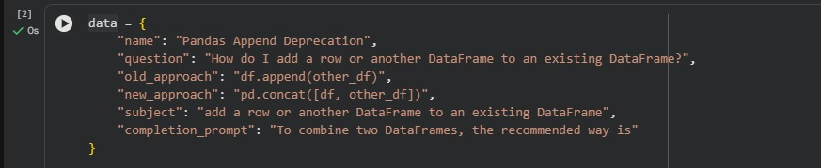
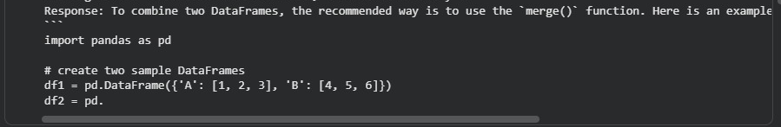
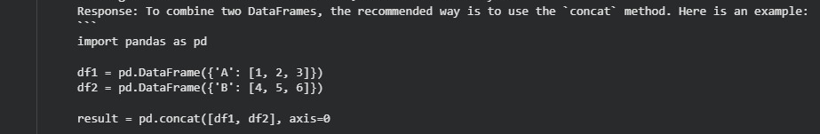
Edit Examples
Motivation
Project Task Description
Building the Data Set
Knowledge Editing Overview
Available Libraries and Resources
Evaluation of Knowledge Editing -kpi’s
Pre Edit Test:
Post Edit Test:

Slide 12
Knowledge Editing Overview
Motivation
Project Task Description
Building the Data Set
Knowledge Editing Overview
Available Libraries and Resources
Evaluation of Knowledge Editing -kpi’s
Opening
Language models contain fixed knowledge and struggle to adapt when facts, APIs, or code libraries change. Retraining is too expensive, and prompting doesn’t reliably fix the model’s behavior.
Knowledge Editing offers a focused way to update a model’s behavior with minimal side effects.
In this project, we evaluate two leading families of editing approaches:
Meta-Learning Methods and Locate and Edit Methods.

Slide 13
Knowledge Editing Overview
Motivation
Project Task Description
Building the Data Set
Knowledge Editing Overview Locate and Edit Methods)
Available Libraries and Resources
Evaluation of Knowledge Editing -kpi’s
Locate and Edit Methods
(ROME, MEMIT, etc.)
First locate where the fact is stored inside the model,
then directly edit the responsible weights (typically in the MLP layers of specific transformer blocks).
How it works:
Run causal analysis to find the “fact-carrying” layer and neuron subset.
Perform a mathematically controlled update to the MLP projection matrices.
  Often rank-1 or low-rank interventions
  .
Advantages:
• Directly rewrites the internal knowledge
• No meta-training required
• Highly local interventions

Slide 14
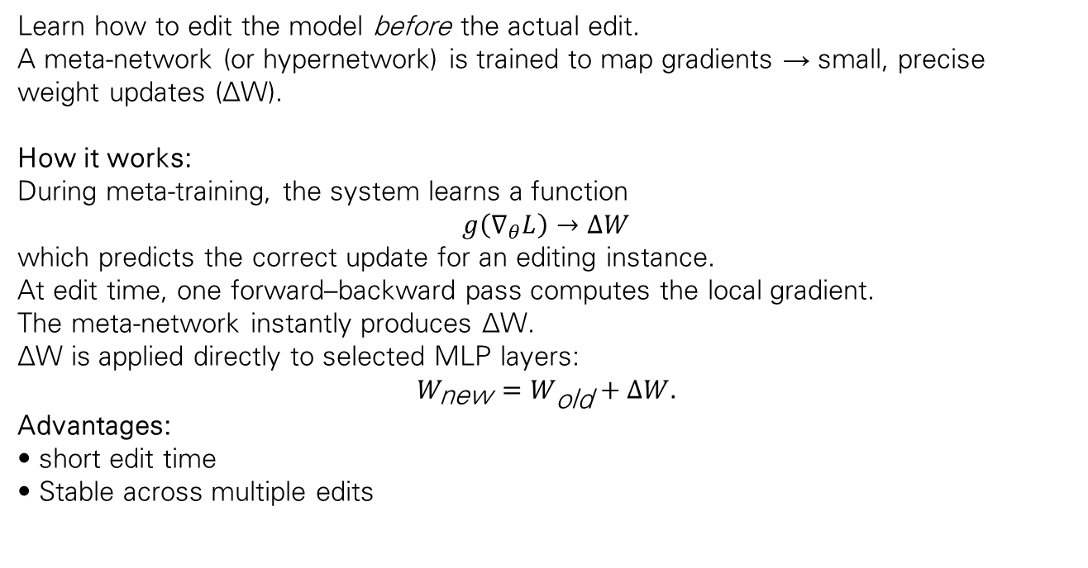
Knowledge Editing Overview
Motivation
Project Task Description
Building the Data Set
Knowledge Editing Overview (Meta -Learning)
Available Libraries and Resources
Evaluation of Knowledge Editing -kpi’s
Meta-Learning Methods
(MEND, MALMEN, etc.)
Learn how to edit the model before the actual edit.
A meta-network (or hypernetwork) is trained to map gradients → small, precise weight updates (ΔW).
How it works:
During meta-training, the system learns a function
$$g\left(∇_{θ}L\right)→ΔW$$
which predicts the correct update for an editing instance.
At edit time, one forward–backward pass computes the local gradient.
The meta-network instantly produces ΔW.
ΔW is applied directly to selected MLP layers:
$$W_{\text{new}}=W_{\text{old}}+ΔW.$$
Advantages:
• short edit time
• Stable across multiple edits

Slide 15
Project Task Description
Motivation
Project Task Description
Building the Data Set
Knowledge Editing Overview
Available Libraries and Resources
Evaluation of Knowledge Editing -kpi’s
Available Libraries and Resources
EasyEdit
Overview: A comprehensive, easy-to-use unified framework for Knowledge Editing in LLMs. It supports altering model behavior efficiently within a specific domain without negatively impacting overall performance.
Models Supported: LLaMA, GPT-J, GPT-2, T5, and Mistral.
Beyond EasyEdit, most KE tools are individual research implementations of specific methods rather than full multi-method libraries.
research implementations of memit : https://github.com/kmeng01/memit
research implementations of ROME: https://github.com/kmeng01/rome
Library Selection:
We selected EasyEdit as our primary tool because it offers a comprehensive and modular framework that has already implemented and unified numerous state-of-the-art editing methods (e.g., ROME, MEND, MEMIT). Its unified syntax makes it significantly easier to use and compare different techniques against our specific code editing task.

Slide 16
Evaluation -
Motivation
Project Task Description
Building the Data Set
Knowledge Editing Overview
Available Libraries and Resources
Evaluation of Knowledge Editing -kpi’s
kpi’s for Reliability
Reliability Check: New Fact Validation
Goal: Confirm that the new information was successfully injected into the model.
Method: Substring / Pattern Matching
Action: Verify that the exact required string (target_new) appears in the model output (model_output).
Formula:
Locality Check: Context Preservation
Goal: Ensure the surrounding context remains coherent, relevant, and unchanged.
Method: Semantic Similarity Metrics ( model_output vs. full_target_new).
Key Tools:
  BERTScore: Measures the semantic closeness of the output to the ideal full target. (Cosine Similarity)
  Formula (Cosine Similarity basis):
  (e1 and e2 are the token embeddings from the two texts.)

Slide 17
Evaluation -
Motivation
Project Task Description
Building the Data Set
Knowledge Editing Overview
Available Libraries and Resources
Evaluation of Knowledge Editing -kpi’s
kpi’s for Locality
Locality Check: Context Preservation
Goal: Ensure the surrounding context remains coherent, relevant, and unchanged.
Method: Semantic Similarity Metrics ( model_output vs. full_target_new).
Key Tools:
  BERTScore: Measures the semantic closeness of the output to the ideal full target. (Cosine Similarity)
  Formula (Cosine Similarity basis):
  (e1 and e2 are the token embeddings from the two texts.)
AST Similarity (Structural Preservation Metric)
Evaluates whether the underlying code structure remains intact—critical for code-model Knowledge Editing.
Method: Tree Edit Distance (TED) or Node Overlap.
Formula (TED-based):
Interpretation:
High AST → the code structure is preserved;
Low AST → the edit altered the flow or logic.

Slide 18
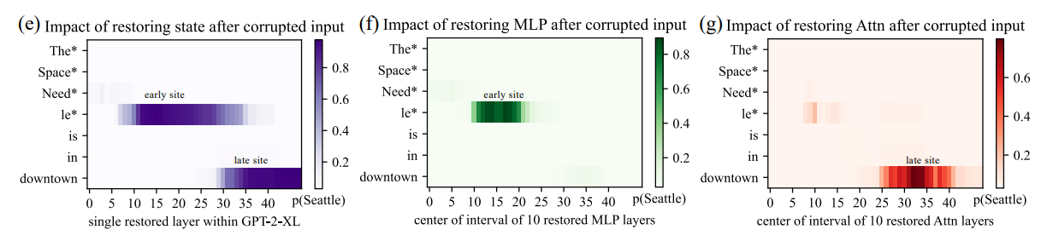
Appendix A - ROME (1)
Using causal tracing, we compare the model’s normal behavior with a version where the subject in the prompt is intentionally corrupted. By restoring individual hidden states to their uncorrupted state, we can observe which internal activations bring back the correct prediction. This reveals that factual knowledge is not scattered randomly across the network, but concentrated in specific mid-layer MLP modules.
when the model processes the last token of the subject, its where these layers show the strongest causal influence on the final answer. This allows us to pinpoint the exact area responsible for recalling a fact. Once this key layer and token position are identified, they become the target for precise editing.

Slide 19
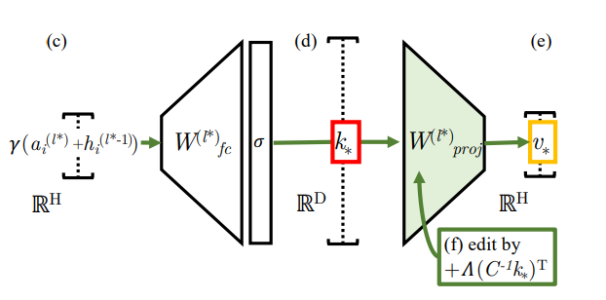
Appendix A - ROME (2)
After locating the responsible layer, ROME rewrites a factual association by treating the MLP module as a key-value memory: the activation at the subject's final token serves as the "key," and ROME computes a corresponding "value" vector representing the corrected fact. With these two components, it applies a rank-one update to the projection matrix of the selected MLP. This update adds a low-rank term that alters the mapping only along a single direction in parameter space, leaving all orthogonal directions—and therefore almost all existing knowledge—unchanged. Because the intervention is so localized, the model reliably retrieves the new fact while continuing to behave normally for unrelated subjects.

Slide 20
Appendix B - MALMEN (1)
MALMEN edits only a small, well-defined part of the model: the second feed-forward layer (FFN-2) inside several late transformer blocks.
This layer is known to store factual associations and behaves like a key–value memory — the same insight used by ROME, which performs a single-fact update in one such layer.
MALMEN extends this idea by applying a consistent update across multiple late blocks, where semantic knowledge is concentrated.
Focusing on FFN-2 keeps the update tightly localized, allowing the model to adjust the specific fact without disturbing its broader linguistic or reasoning abilities.

Slide 21
Appendix B - MALMEN (1)
MALMEN uses a meta-learned hyper-network to turn raw gradients into safe, localized parameter shifts.
For each fact to be edited, the LLM produces keys and value-gradients that describe how the model currently represents the incorrect fact.
The hyper-network transforms these gradients into small “micro-updates,” one per token, predicting how FFN-2 should change to express the corrected fact.
Instead of summing these updates (which leads to cancellation), MALMEN aggregates them using a least-squares solution that produces a single optimal update matrix
This unified update is then applied simultaneously to the FFN-2 layer across all selected blocks.

